Slide 1
Pandamonium
Robby Jones
Noah Estrada-Rand

Slide 2
Four core Features
Character Design
Four unique characters
Level Design
Three unique maps
Character Selection
A little behind the scenes
Gameplay Mechanics
How it all comes together at once

Slide 3
Character Design
Movement
Attack and block
Super ATACK
Left and right
Can jump (or fly if falcon)
Deals damage based on character
Blocking causes a stun effect
Can still push character if they are blocking
- Unique super attack for each character adds a lot of variability to fights

Slide 4
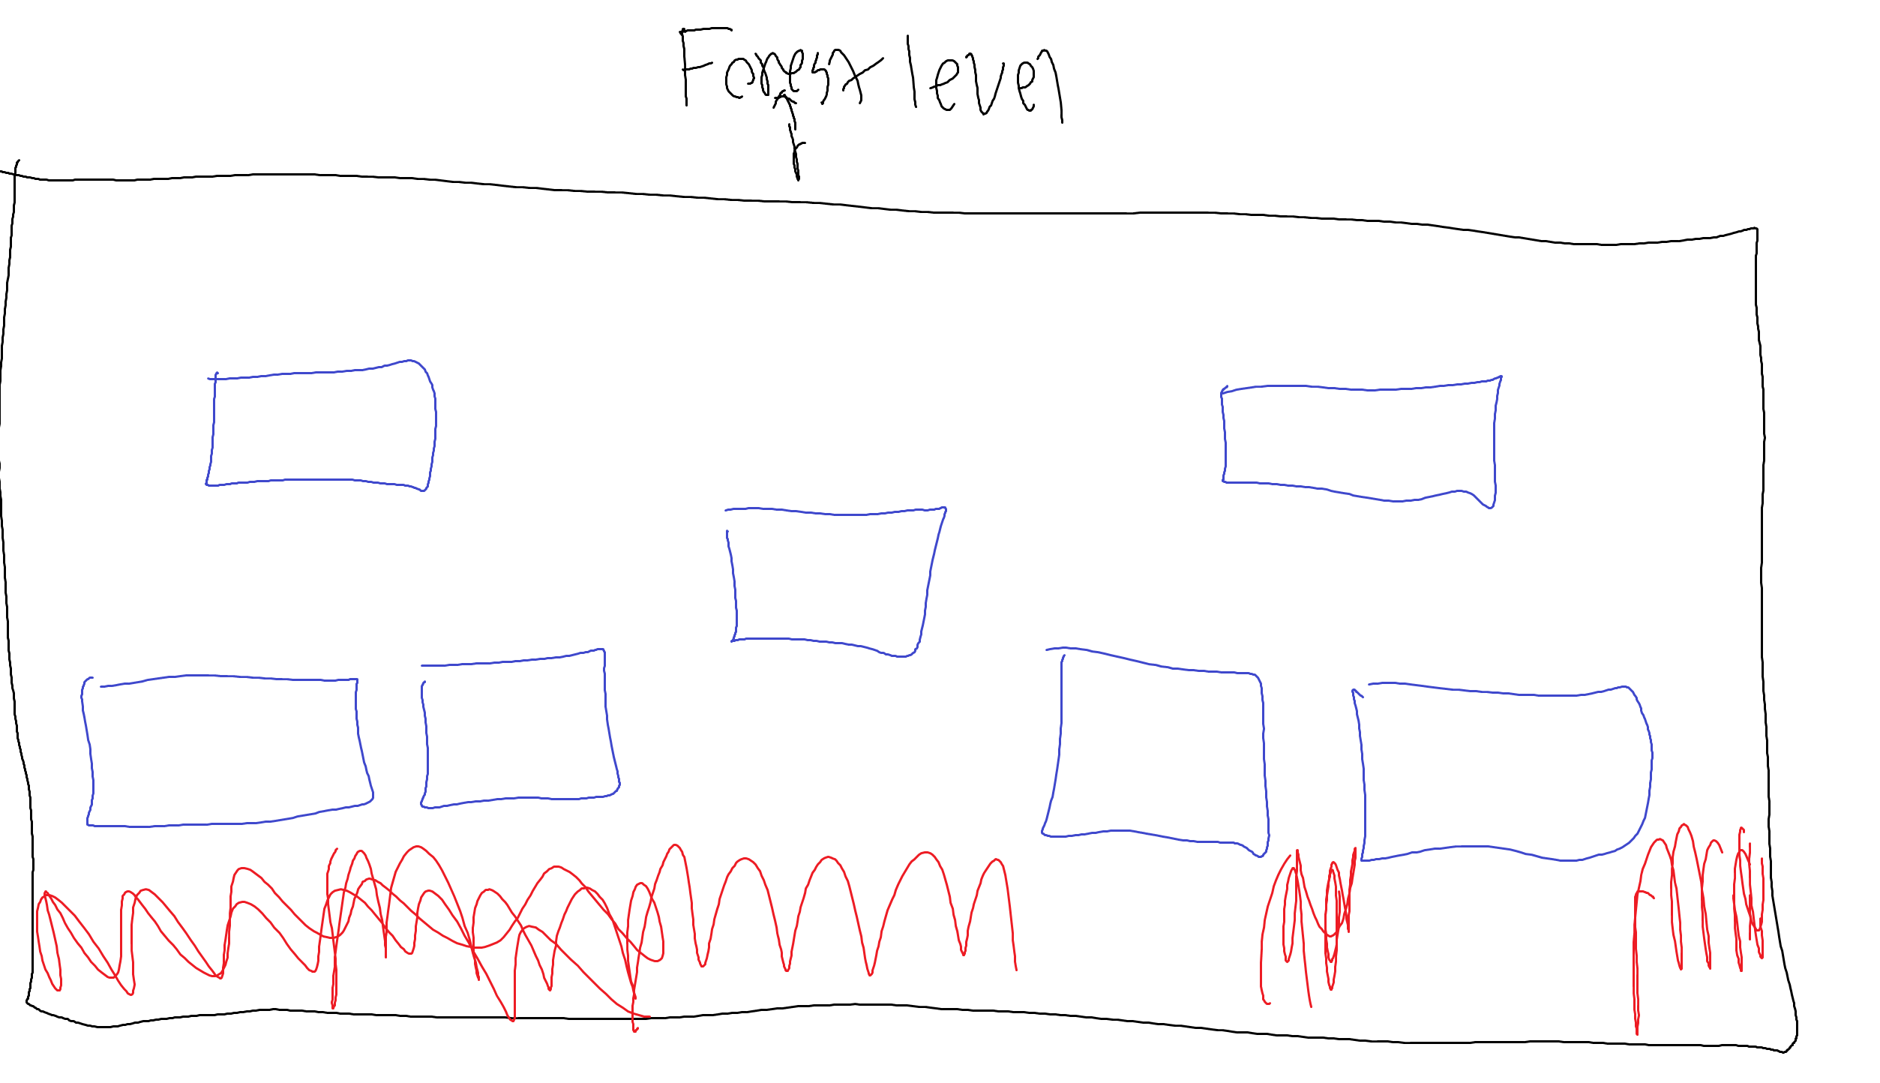

Slide 5
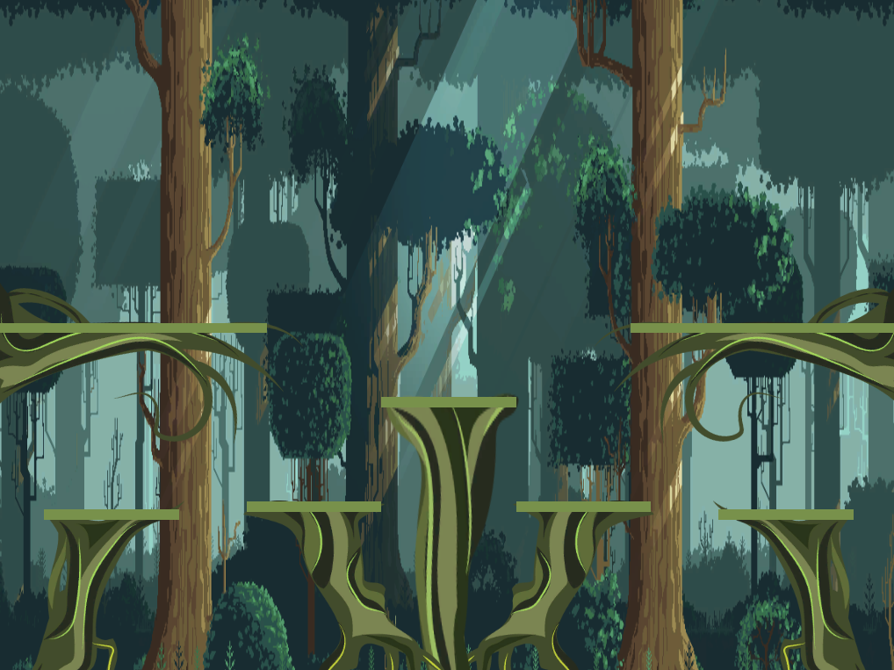

Slide 6
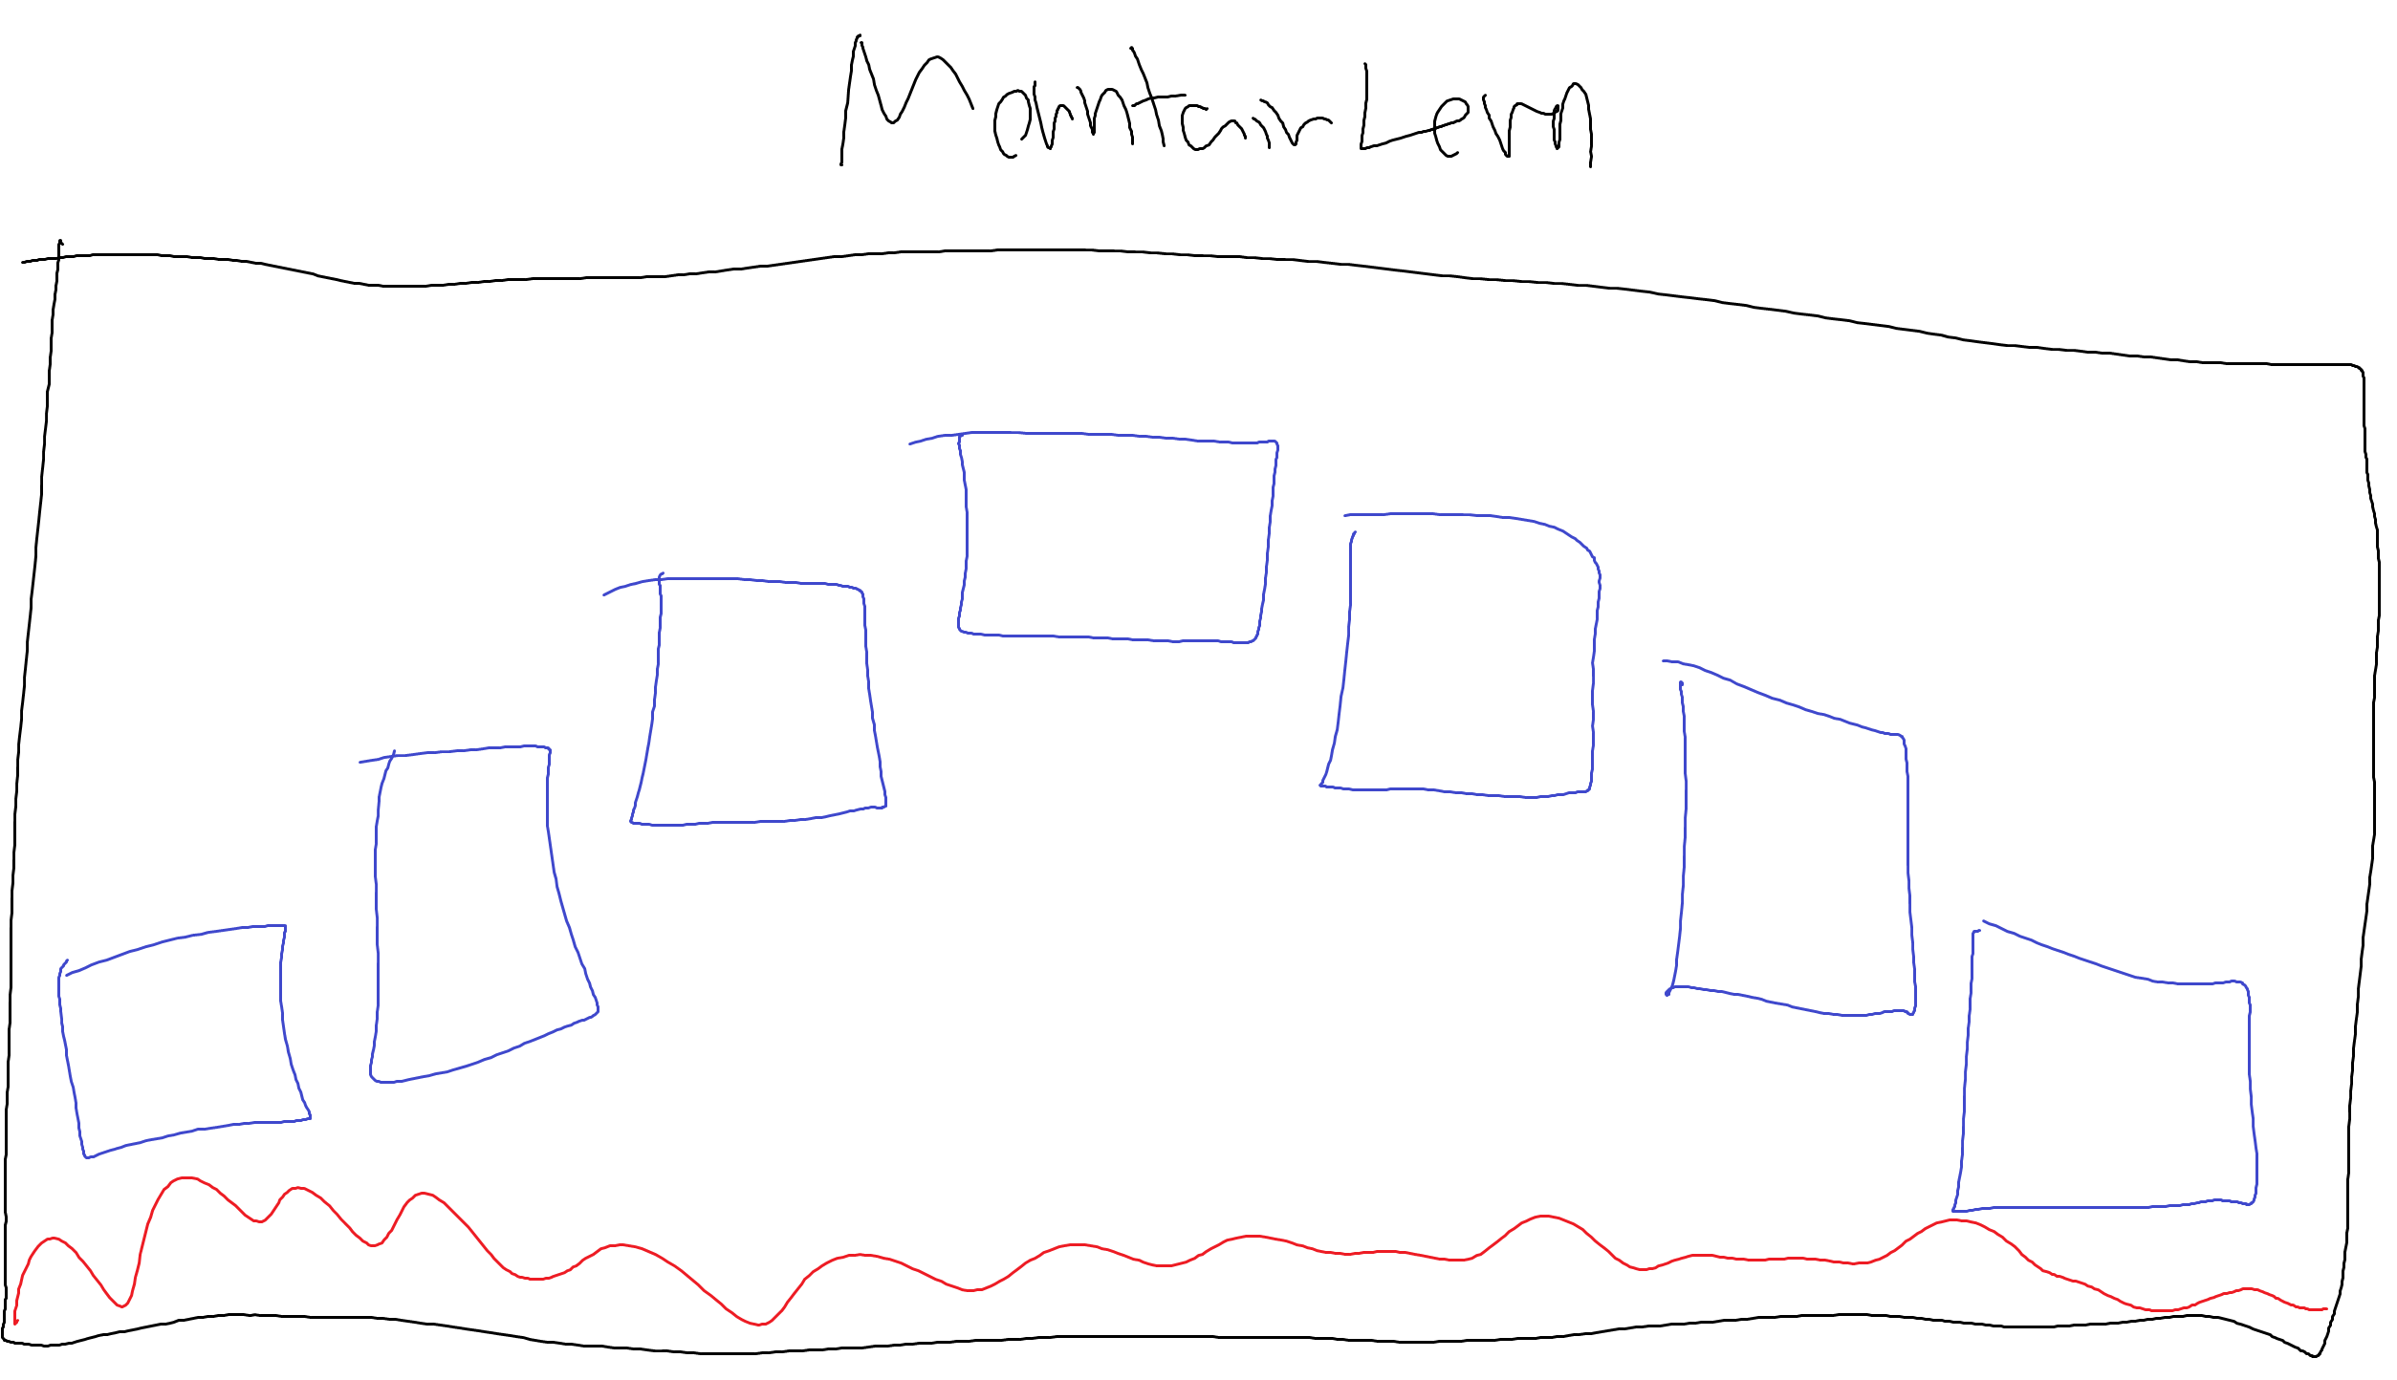

Slide 7
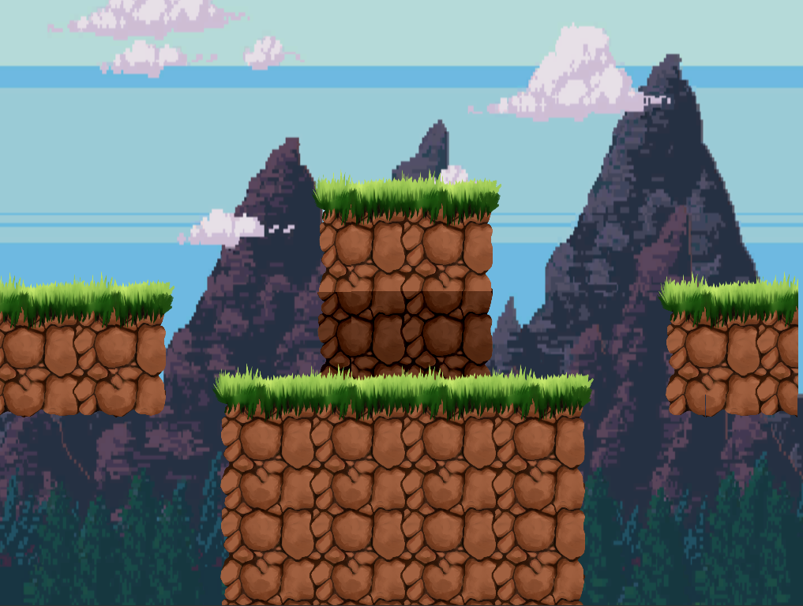

Slide 8
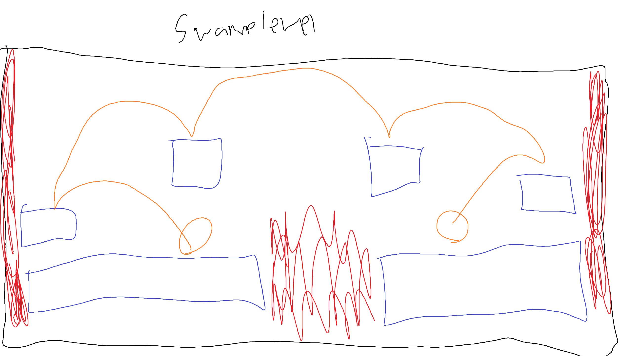

Slide 9
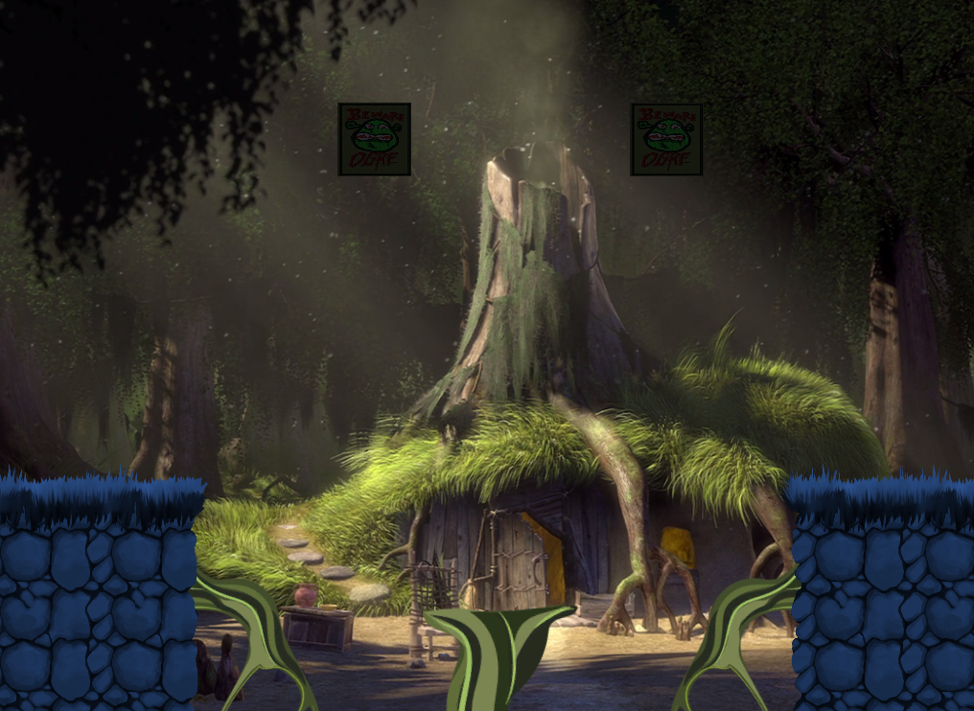

Slide 10
Level Design
Forest
Two levels which promotes tactics between characters
Mountain
Cave like area
Hard to fall off the map; promotes more fighting to the end
Swamp
Moving platforms that allow for a height advantage
Low crossing area; easy to fall off map
Most “balanced” map
Fewest blocks
Combination of two previous levels

Slide 11
Behind the scenes of the character selector
Uses a DoNotDestroyonLoad Script
Each button runs a method that sets a variable
The “return to title” button takes you back to the start screen
CharacterSelecter will destroy itself if it detects that another CharacterSelecter is already loaded

Slide 12
Attacking mechanics
A game manager script checks for if winning or losing case is met
If so then the game is over
A character manager script is constantly checking to see if characters were hit
If so, then it calls a method to detract from player health
Also checks to see what kind of attack was used

Slide 13
Thank You Now let’s play!

